Slide 1
Machine Learning 2020 – Assignment 2
José Pinto up201603713
Nirbhaya Shaji up201900679
Nuno Costa up200808441
Mariana Monteiro up201909212
Introduction
Estimating housing values is very important for a variety of entities like governments, banks, house-owners and house-seekers.
It is typically not an easy problem. First of all because it's a somewhat subjective value. Different parties might have different perspectives and opinions that might be well-grounded or not, perspectives that highly depend on the individual's knowledge extent. Even if people had trivial access to all objective and non-sentimental variables involved, it is not guaranteed that a general agreement could be reached. So in the mundane conditions that we are used to, the problem is even more complex. A classic example are real-estate bubbles. This is mainly due to the limitations of available data and the general high dimensionality of the data.
For this assignment we have the objective of building a full machine learning pipeline and develop regression models that can be used on predicting housing values in Melbourne. This will subsequently serve the true assignment’s objective which is honing our data science skills ☺
Exploratory Data Analysis
Training Data
ML Pipeline
Take a global look at the data. Analyze basic statistics. Plot correlations and distributions. Discuss possible errors in the dataset.
Train-Test split. Trying different regression models and fine-tuning hyper parameters using cross-validation.
Models tested
Decision Trees
Random Forest
Boosted Trees
SVM
Bagged ANN
Feature Engineering
Re-convert data types and mutate features. Fill NaNs using different techniques. Encode categorical features. Remove outliers. Create multiple data frames with different data transformation processes (One-hot, standardization, box-cox, etc).
Evaluation Metrics
Comparing test-set RMSE for each model and also benchmarking with baseline models (Price average and price average by suburb).

Slide 2
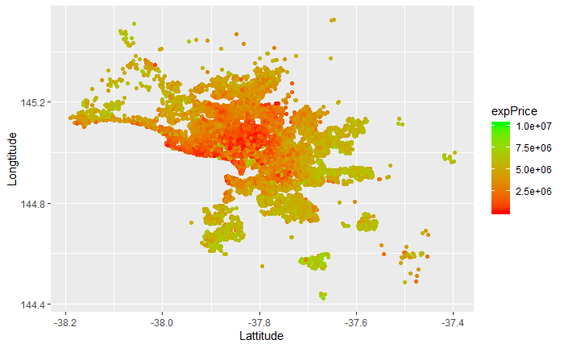
Exploratory Data Analysis
Data Understanding
Price
We start by using GGAlly that enables a global view of correlations and distributions in a compact way. For the sake of keeping the presentation tidy, we have placed the output in the appendix page.
Some features are also correlated with the target variable, hopefully we will use it in our advantage.
Low
High
Key takeaways:
Some features have unreasonable values, such as a house built in the 12th century, properties with 20 bedrooms, 10 bathrooms or 18 car spots and so on. While we don’t discuss the veracity of this, since they are so few examples, it will probably confuse the model and it might be better to remove them.
There are a lot of missing values. The most problematic one is our target variable, and working with its NaNs would require a non-supervised learning process, but we can’t think of any way in which it could help our objective for this time.
As for the predictors, NaN percentages range from 0% (complete columns) to 60.58%. Given that the original dataset has a good number of observations (34857), by deleting such rows we would still have more than 10k entries to work with, and we consider that this could be enough for the models we’re using. (It would be ideal to data-verify this statement.)
As an example, houses near downtown are generally more expensive.
Feature | # of unique values
Suburb | 351
Address | 34009
Seller name | 388
Council Area | 34
As for categorical predictors, some of them have over 300 unique values, which makes it unfeasible to perform any kind of encoding.
Other strange happenings are 7 rows with Year built > Year Sold and more than 1000 rows where Building Area > Land Size.
Since we’re not sure of what’s happening and it doesn’t seem to be such big logic violation we leave it as is.

Slide 3
Feature Engineering
Imputation
Derivations
The first thing we paid attention to was dealing with the big amount of NaNs:
Removed them from Price column. Data Frame became 78% of the original size.
On Latitude and Longitude we performed imputation of the mean value by suburb and created a visualization to validate the task.
We took advantage of the correlation between Car spot, bedroom number and Bathroom number and filled missing values with KNN imputation.
Similar process for Land size and Building Area.
Other predictors with missing values were removed since there is little ground to believe we could fill them with anything useful.
As for derivations we’ve split Address into street name and door number. It could be that there is some urban planning aspect connected to door number. For example, here in Portugal we can observe many times odd and even door number houses on opposite sides of the street, this could allow some conclusion about south-facing houses, which has an impact on price.
We’ve also decomposed data into day of the week, day of the month, month and year. Although the relations could be picked up by the models, we like to think that this could dissipate noise and ease the burden of our ML allies .
Transformations
We work with a dataset 27% the size of the original data.
Creation of different data-frames to be used with different models:
One-hot encoding for remaining categorical variables.
Box-cox transformation for distributions become more ”normal”. Not compatible with Year and Postcode.
Standardization of box-cox applied data-frame in orded to even out different scales.
Any of the above with log(target value).
Outlier handling
We‘ve removed the instances where values have a distance equal or greater than 2.5 of the interquartile range. The reference value is 1.5 IQR but we prefer to allow generalization to more extreme values. Higher than this limit and we could be compromising our models’ predictions.

Slide 4
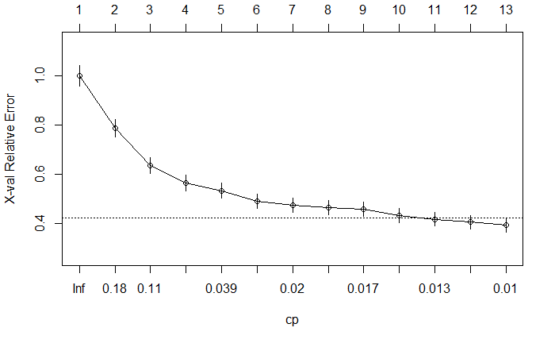
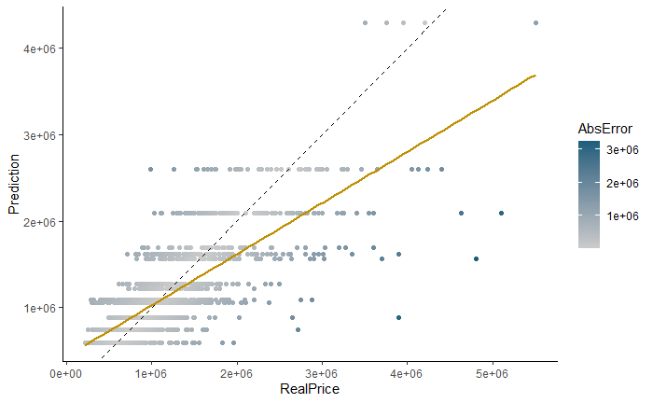
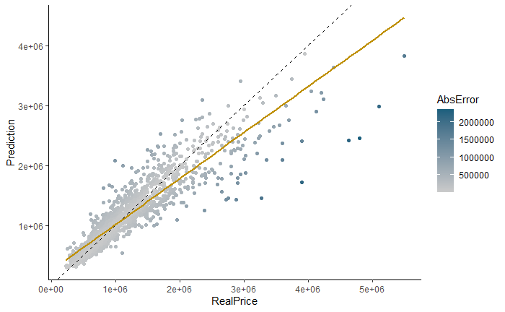
RF, Trees
It is worth to notice that as complexity of the trees grew, the error consistently dropped.
The first two models we tried were Regression Trees and Random Forests. They were tested both on the regular data and on the log transformed one. As the later kept giving poorer RMSE values, cross validation and hyperparameter tuning was performed only for the regular dataset.
Baseline Performance
RMSE (AUSD) | mean | median
Total | 651653$ | 676894$
By suburb | 502896$ | 512315$
Trees
Random Forest
CV RMSE = $
Test set RMSE = 409285$
CV RMSE = $
Test set RMSE = 265607$

Slide 5
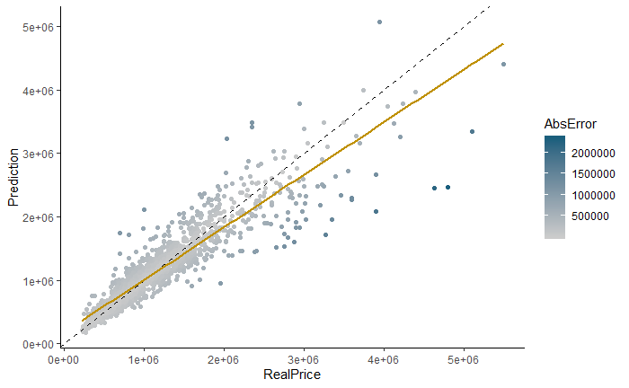
Boosted Trees
We’ve tried a stepwise approach starting with a single tree, to a 100 tree bosting strategy and tried to tweak the parameters a bit just to confirm that with more trees the error decreases. From there we did a 10 fold cross validation fine-tuning tree number, learning rate for gradient descent, interaction depth and minobsinnode. After many hours waiting we decided to take the following hyperparameters:
Number of trees 3200; interaction depth 15; minobsinnode 5; learning rate 0.05
Predictions vs Real Price
Equality line (perfect prediction)
CV RMSE = 234531$
Test set RMSE = 247325$
Linear regression of Prediction vs Real Price

Slide 6
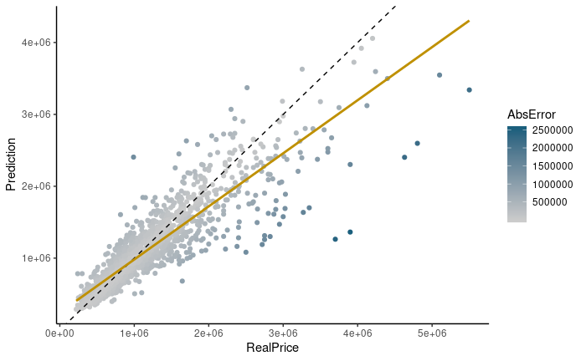
SVM
We started with the objective to find the best parametrization for SVM. Since in comparison with other models, SVM tends to deliver better accuracy due to its ability of fitting nonlinear boundaries, we started of with a simple sigmoid kernel and proceeded to linear, polynomial and radial kernels. As expected, a better fit was obtained with more complex kernels.
sigmoid
linear
polinomial
RBF
Starting with a sigmoid kernel and ending with an RBF, our performance improved, as RMSE lowered.
It was verified that none of the parameter combination performed better than the default with an RBF kernel. A 10 fold cross validation with this setting on the log-transformed target gave the lowest RMSE, which is a modest result when compared to the other (ensemble) models we tried.
CV RMSE = 287976$
Test set RMSE = 301685$
Equality line (perfect prediction)
Linear regression of Prediction vs Real Price
Note
One of the biggest drawbacks was the time. SVM turned out to be the slowest method to fit the training set. This made it pretty hard to tune the hyperparameters.
RBF kernel
Target | # Support Vectors | RMSE
Normal | 4914 | 301685$
Log | 5597 | 296728$
The log-transformed target consistently gave a better RMSE for all kernel configurations.

Slide 7
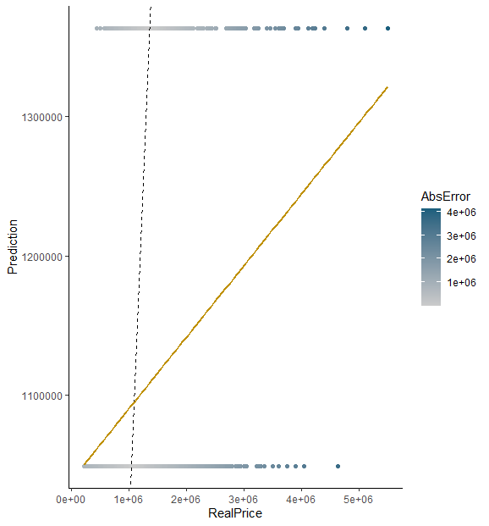
Predictions vs Real Price For Standardized Regular Target
Bagged ANN
For bagging we chose an unconventional model, artificial neural networks (ANN). Due to the inherent randomness and variability of ANN, bagging was supposed to make it more consistent, and improve overall results.
Unfortunately, due to time and resource constrains, coupled with no preexisting implementation of this, fine tuning proved impossible, the ANN got limited to an MLP and results severely suffered.
For one hot encoded, size 2 and number of models 1
For one hot encoded log target, size 1 and number of models 1
For box-cox, size 1 and number of models 1
For box-cox log target, size 1 and number of models 1
For standardized, size 0 and number of models 1
For standardized log target, size 0 and number of models 2
For all datasets, the parameters selected by cross validation, have low hidden layer size and number of models, which prevents the advantages of bagging.
CV Bagged ANN
RMSE (AUSD) | One Hot Encoded | Box-Cox | Standardized
Regular Target | 651592$ | 651592$ | 627167$
Log Target | 667544$ | 667544$ | 667544$
CV RMSE = 628317$
Test set RMSE = 627167$

Slide 8
Conclusions

Slide 9
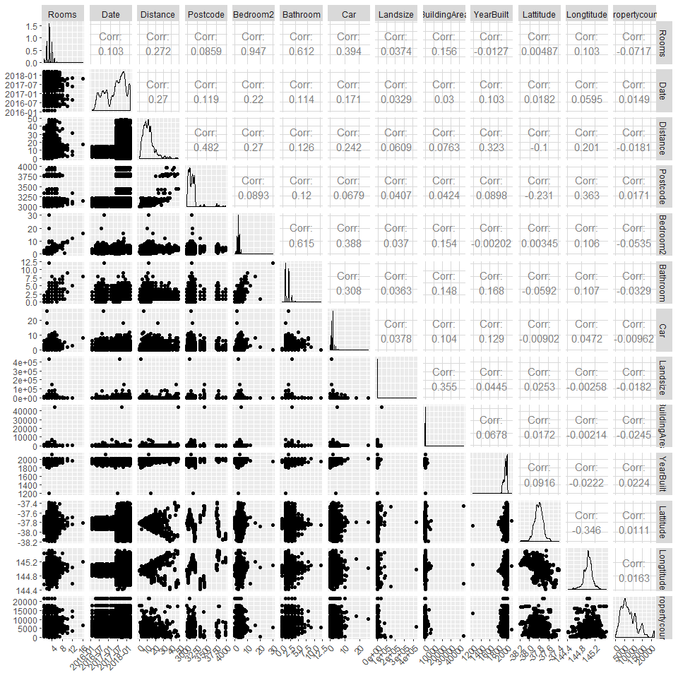
Appendix

